Slide 1

Lecture 7
-NLP is all about words, their arrangement and their meaning
-NLP is a branch of AI that tries to emulate/understand the way a human speaks to another human
-Lecture 7 is about Lemmatization (similar to stemming)

Slide 2
Lemmatization
Lemmatization is similar to stemming
Each word is converted to the base word or root word called lemma
Lemmatization considers POS & context of the word while converting
Like stemming, the root word may sometimes be the same as the original word eg. For the word door→ door
In some cases, stem and lemma of a word is same and in some cases they are different eg. For the word celebrations→celebration
You may decide between stemming or lemmatization (or neither!) for your project (based on what gives the highest accuracy)

Slide 3
Stemming vs Lemmatization
In some cases, stem and lemma of a word is same and sometimes different
Examples: Conversion of the following words:
celebrations→celebration [LEMMATIZATION]
celebrations→celebrate [STEMMING]
celebrate→celebrate [STEMMING, LEMMATIZATION]
Wolves→Wolv [STEMMING]
Wolves→Wolf [LEMMATIZATION]
feet→feet [STEMMING]
feet→foot [LEMMATIZATION]
foot→foot [STEMMING, LEMMATIZATION]

Slide 4
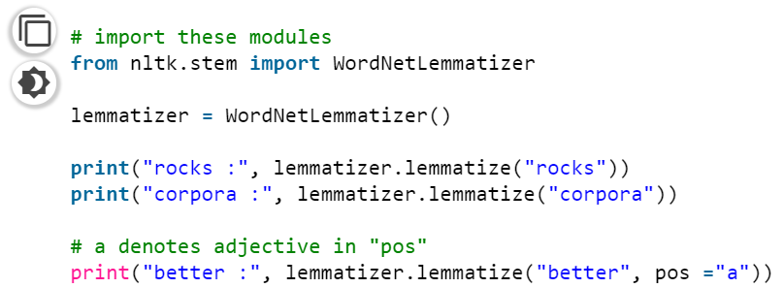
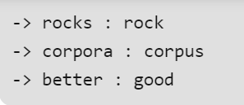
Programming (by importing the WORDNET lemmatizer)
https://www.geeksforgeeks.org/python-lemmatization-with-nltk/

Slide 5
Answer the programming Assignment of this week related to Lectures 6 and 7 in the link provided in MOODLE (by Tuesday 1st Sept’20 11 pm)

